Slide 1
Lost Souls: Mapping the Haunted Connections
Jared Pavlik
Peiwen Chiu
Richard Wallace

Slide 2
Motivations
Around Halloween time thrill seekers are interested in haunted location near their area. To explore and find a such a thrill. We are using data of haunted locations, coupled with looking at geographic data. Such as, Rural, Suburban, City locations. As well as, refining it further into look at specific landmark locations in proximity, these markers are hospitals, cemeteries, and historic sites

Slide 3
Objections
Create a user-friendly website that individuals can go on to find potential sites to visit. End-state would be an interactive map that individuals can view reported haunted sites throughout Kansas. Additionally, where these reported sites were in relations to other notable sites. The interactive map would show if there were potential correlations between the reported haunted sites and other landmarks that are normally associated with being haunted.

Slide 4
Gather Data
Data Cleaning
Data Storage
JavaScript coding
HTML Coding
Data Conversion

Slide 5
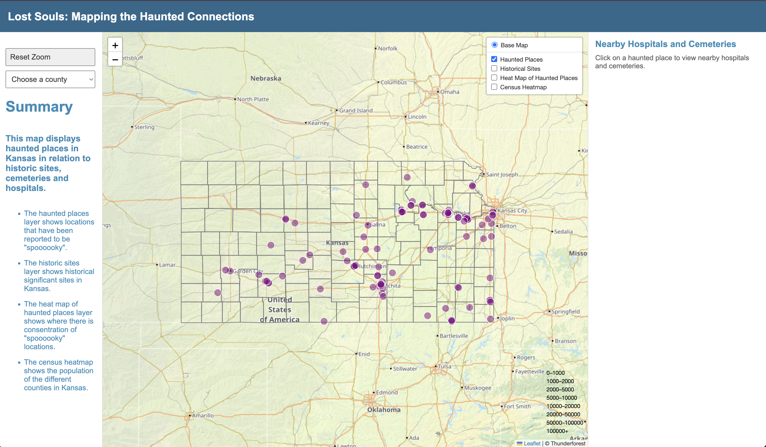
Website

